Slide 1
Chapter 2 Polynomials
Study material ( Maths class 10 ) part 1
Contents are :
Introduction of Polynomial
Zeros of Polynomials
Relationship Between Zeros and Coefficents of a Polynomial
Prepared by :
Pranav Kumar Semwal

Slide 2
Polynomials
An algebraic expression containing variables and constants where powers of variables should be a whole number, along with mathematical operations e. g. Add, Sub. etc are called polynomials.
Ex. 1 5x, 2x+4 , x+ 3y+1
Ex. 2 √x +1, x⁻² + y, 5/(x +3) are not polynomials
In ex. 1 first two are polynomials in one variable and third is polynomial in two vaeiables. So we can say that a polynomial can be of any number of variables.
Degree of Polynomial : - the highest power of the variable in a polynomial is called the degree of polynomial.

Slide 3
Types of Polynomials
On the basis of degree there are different kinds of polynomials:
A polynomial of degree 1 is called linear polynomial. Ex. 2x+3
A polynomial of degree 2 is called quadratic polynomial. Ex. x²+2x+1
A polynomial of degree 3 is called cubic polynomial. Ex. x³+2x²+3.
Zeros of a Polynomail:- If y= p(x) is a polynomial of any degree then the real number k is said to be a zero of polynomial if p(k)= 0. In general we can say that the value of variable of polynomial at which the given polynomial becomes zero is called the zero of a polynomial. A polynomial can have one or more then one zeros, it depends on degree of polynomial.
In general if k is a zero of polynomial p(x)= ax+b, then p(k)= ak+b= 0 which gives k= -b/a. So the zero of linear polynomial ax+b is –b/a .

Slide 4
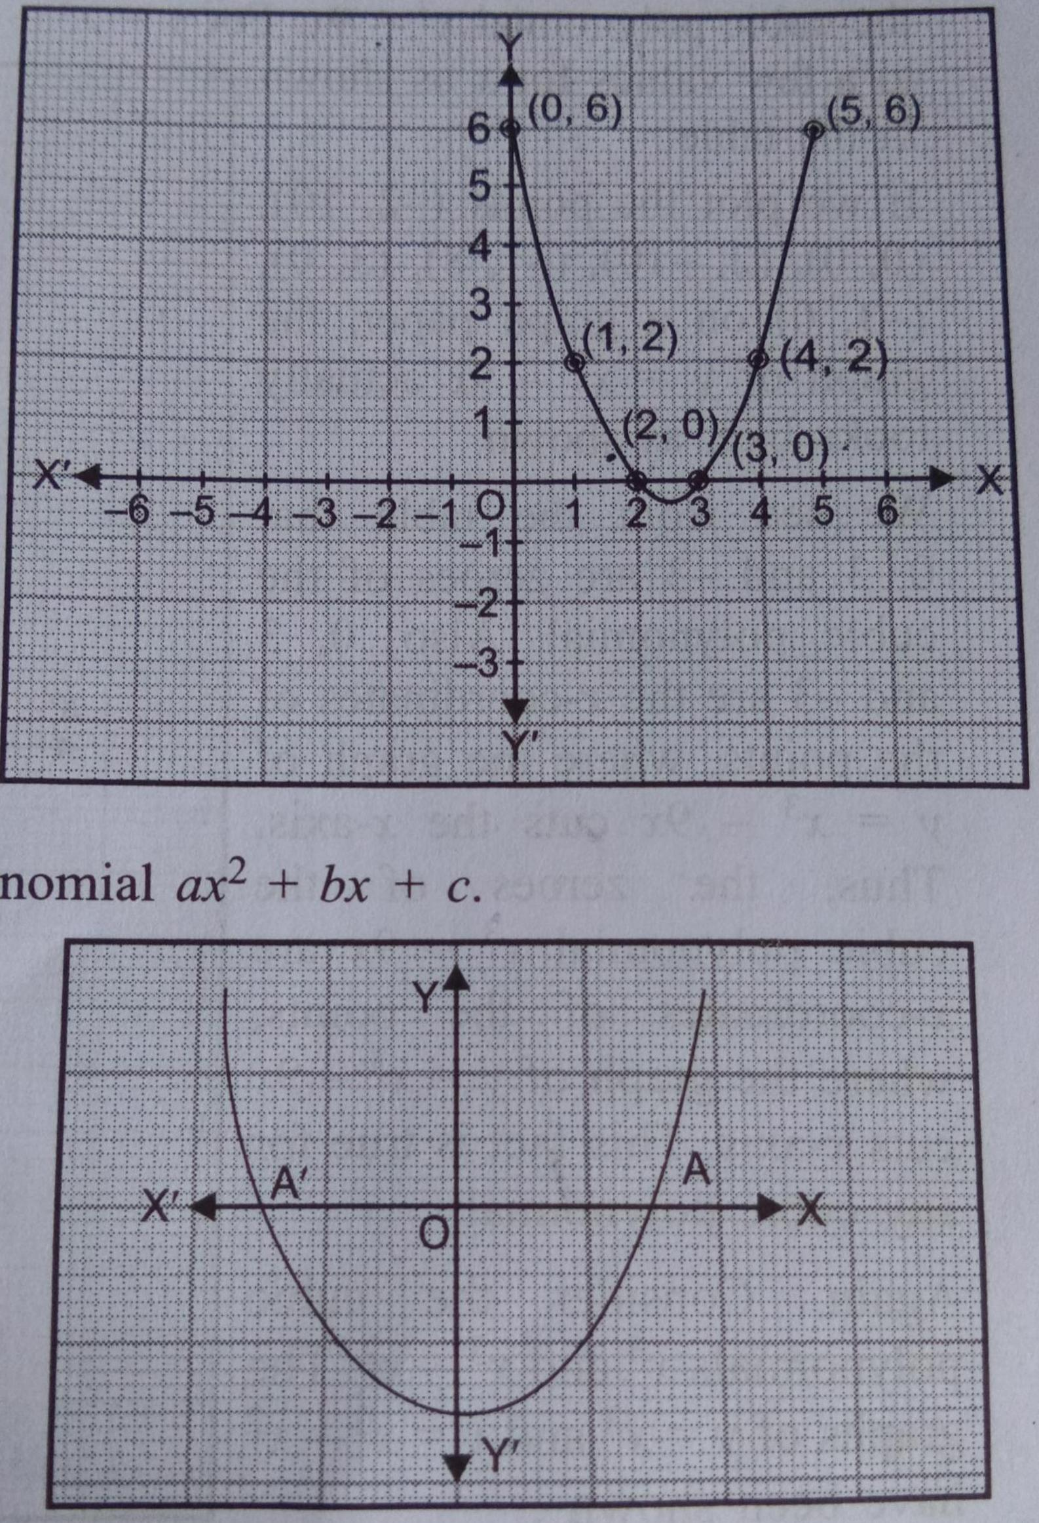
Geometrical Meaning of Zeros of Polynomial
As we know that the graph of a linear polynomial ax+b, is a straight line and the x-coordinate of the point, where graph cuts the x-axis is the zeros of the linear polynomial.
But for quadratic or cubic or more other polynomials of degree more then 3, the graph will be a curve, then the number of zeros of these polynomials are the number of points, where the curve intersects the x-axis.

Slide 5
Relationship Between Zeros and Coefficients of a Polynomial
Let us consider a quadratic polynomial ax²+bx+c=0. Then it have two zeros, the relationship between zeros and the coefficients are given as follows :
Sum of Zeros = -(coefficient of x) /coefficient of x²
Product of Zeros = constent term / coefficient of x²
Or we can say that if α and β are the zeros of quadratic polynomial
Then we have .
α+β = -b/a
α. Β = c/a

